Slide 1
Have Some Cake With Your Frosting:
Testing Both the UI and API Layers

Slide 2
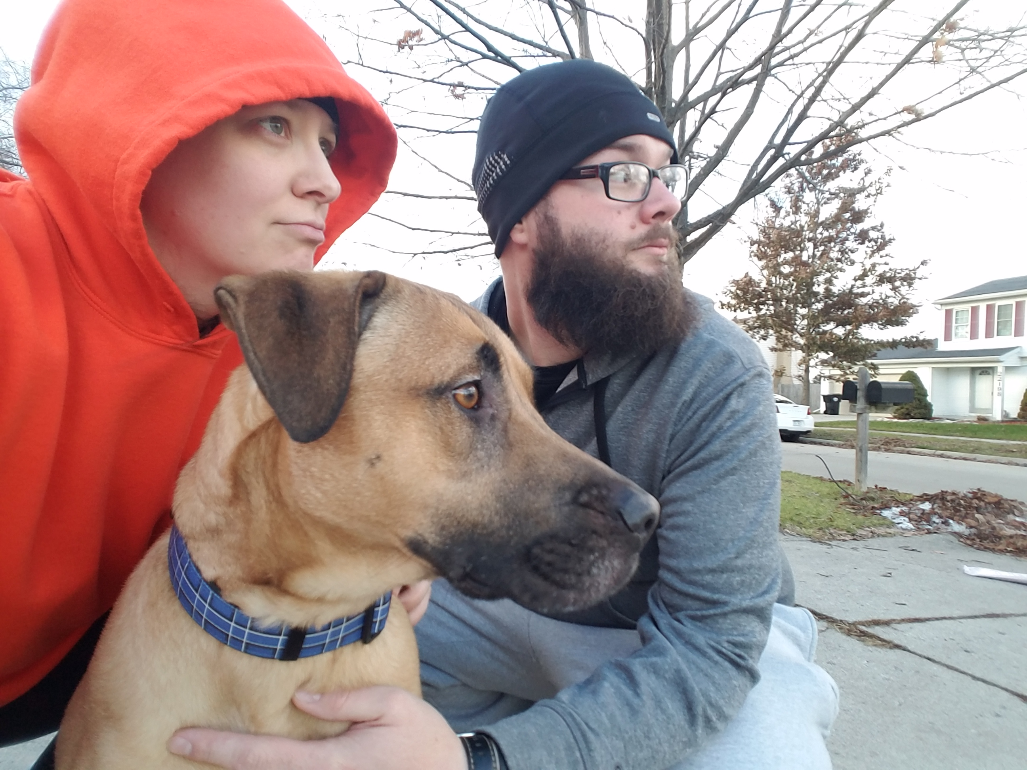
New slides, who dis?
Hilary Weaver-Robb
SQA Architect @ Quicken Loans - Detroit

Slide 3

Objective
Define web services and APIs
Why web services and APIs are important to test
HTTP Response Codes & how they fit in to your testing
Finding the API calls your UI is making
How familiar UI tests translate to API tests
Using Postman
Note: when you see this icon, it means we will be hands-on

Slide 4
Level Setting
API and Web Service Definitions

Slide 5


Slide 6
What is an API?
APIs keep developers from having to reinvent the wheel
App that requires pinch-zoom
Interact with printers
Include Google Ads in your website
Use Facebook authentication
App that sends push notifications
App that uses an external address validation service

Slide 7
What is a Web Service?
Web Service is machine-to-machine interaction over a network
A Web Service needs a network connection while an API may not
All Web Services are APIs but not all APIs are Web Services

Slide 8
API vs Web Service
API but not Web Service
App that requires pinch-zoom
Web Service
Include Google Ads in your website
Interact with printers
App that sends push notifications
Use Facebook authentication
Interact with printers
App that uses an external address validation service

Slide 9
SOAP – Simple Object Access Protocol
Data Format
XML
SOAP Envelope
Communication
HTTP
Definition
WSDL or Web Service Definition Language
SMTP
TCP
JMS
Single endpoint

Slide 10
REST – Representational State Transfer
Data Format
XML
JSON
Communication
HTTP
Definition
WADL or Web Application Description Language
RAML or RESTful API Modeling Language
Swagger or OpenAPI
URL
Multiple endpoints

Slide 11
GraphQL – Graph Query Language
Data Format
JSON-like
Communication
HTTP
Definition
SDL or Schema Definition Language
Single endpoint

Slide 12
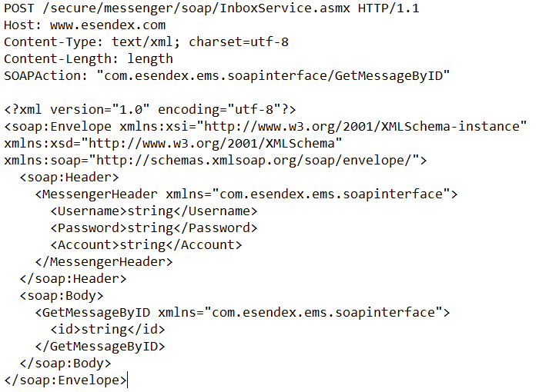
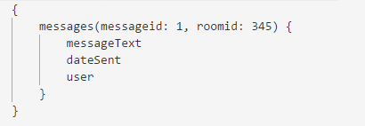
Comparison

Slide 13
Focus on REST Web Services
URL tells you what you’re working with and doing
Messages can be lightweight (even just the URL!)
WAY easier to test than SOAP services

Slide 14
CRUD
Create
POST
Read
Update
PUT
Delete
DELETE
GET

Slide 15
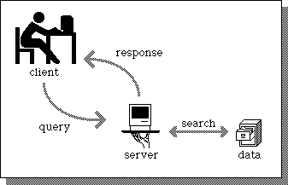

Client-Server
Client-Server architecture using HTTP protocol
Client sends Request to Server
Server sends Response back

Slide 16
Why Test Web Services or APIs?

Slide 17
Why Test Web Services?
HTML &
CSS
JavaScript
API
Backend

Slide 18

Why Test Web Services?
Someone else’s code
API Client
API
Backend

Slide 19
Why Test Web Services?
Usually complete before UI is even started
Not everyone wants to use the UI!
Validate the ductwork
UI can pull in multiple Web services
Because it’s code!
UI Tests
Integration Tests
Unit Tests

Slide 20


Slide 21
HTTP Response Codes and How They Fit

Slide 22
HTTP Response Codes
Indicate if HTTP request is successful or not
Informational (100s)
Successful (200s)
Redirects (300s)
Client Errors (400s)
Server Errors (500s)

Slide 23
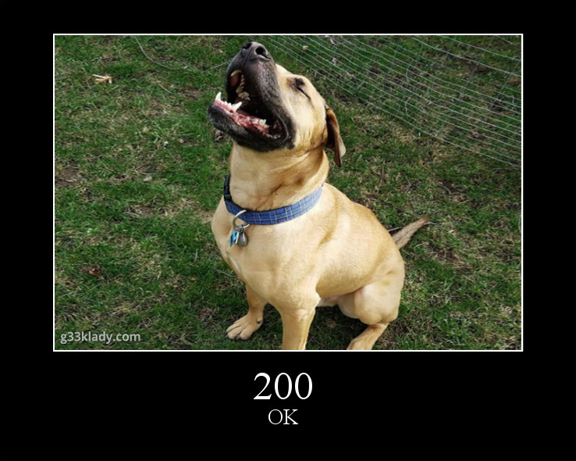
Most Common HTTP Response Codes
Successful Codes (200s)
200 OK
201 Created
204 No Content

Slide 24
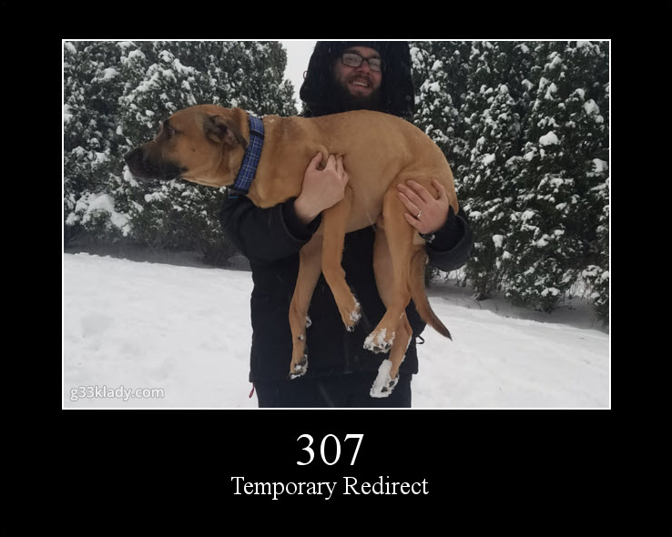
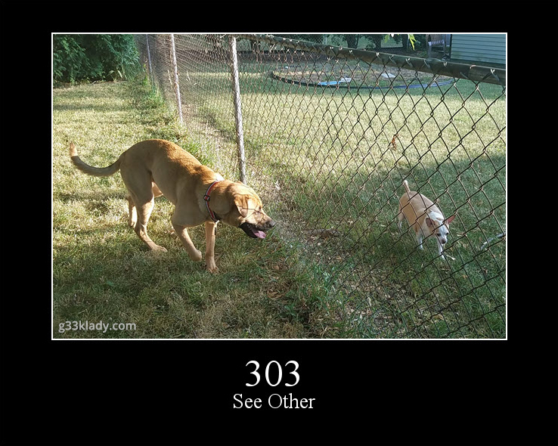
Most Common HTTP Response Codes
Redirection Codes
303 See Other
307 Temporary Redirect

Slide 25
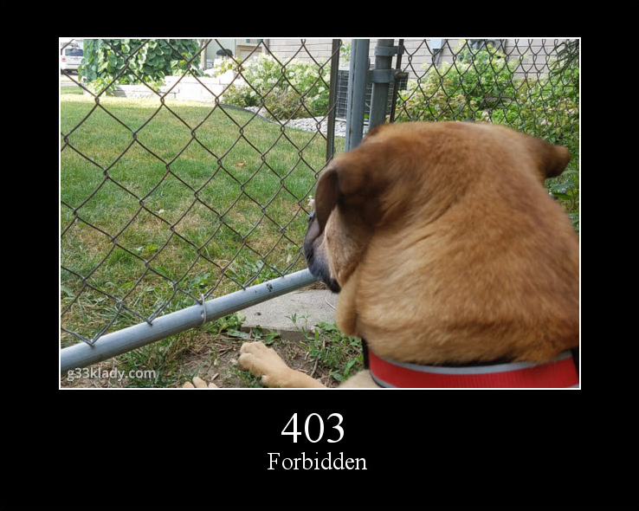
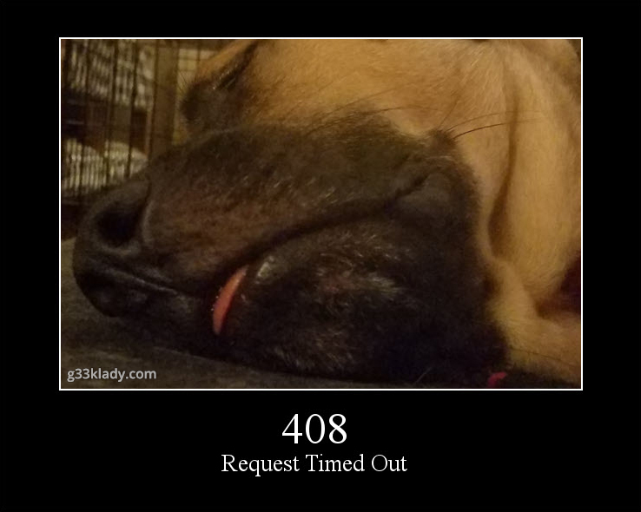
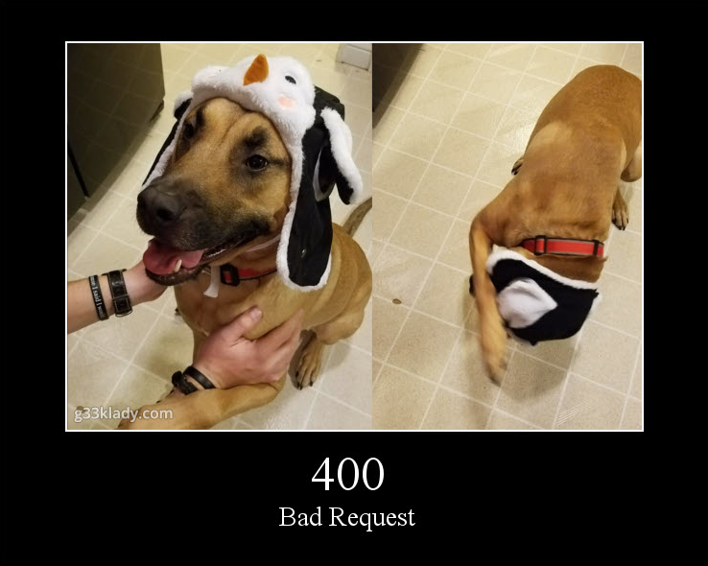
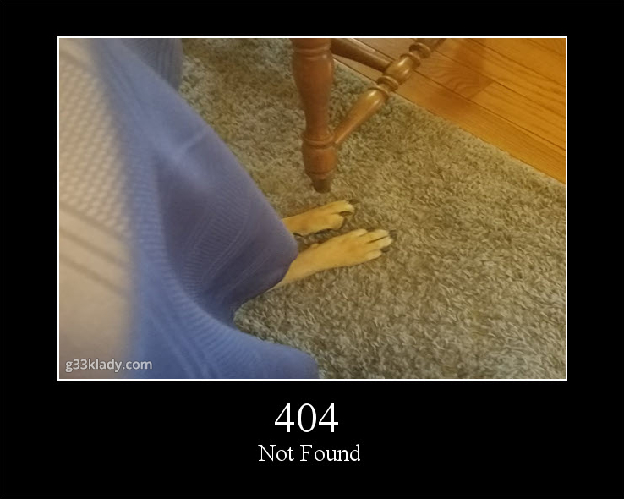
Most Common HTTP Response Codes
Client Error Codes
400 Bad Request
401 Unauthorized
403 Forbidden
404 Not Found
408 Request Timed Out

Slide 26
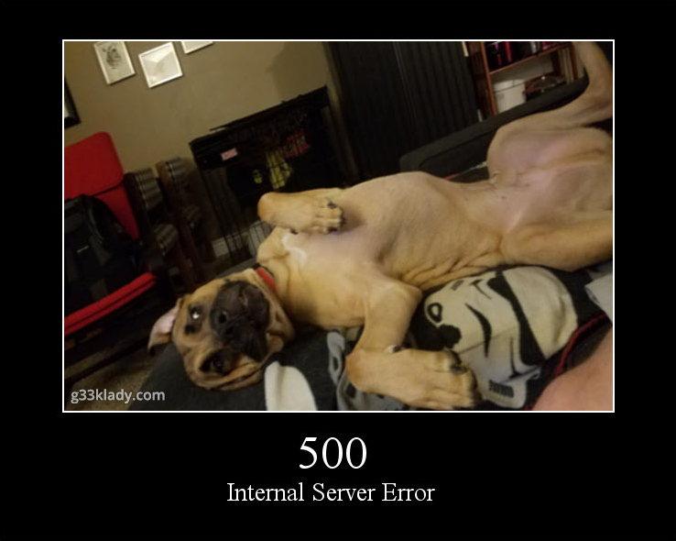
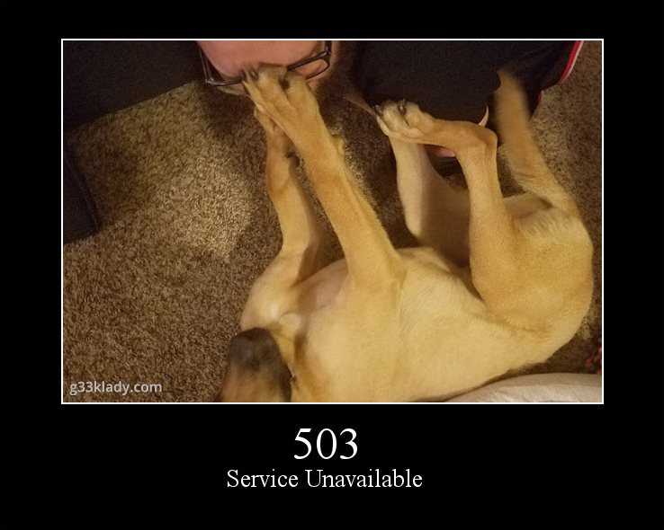
Most Common HTTP Response Codes
Server Error Codes
500 Internal Server Error
503 Service Unavailable

Slide 27
How Can We Test Web Services?

Slide 28
What Types of Tests Can We Perform?
Smoke tests
CRUD tests
Boundary
Required Fields
Field Type
Error Conditions
Security
Performance
Contract

Slide 29
How Can We Test Web Services?
Manual Testing Tools
Postman
Fiddler
Advanced REST Client
ReadyAPI (SoapUI)
Swagger
Insomnia
Automation Tools
Postman
ReadyAPI
Most unit testing frameworks

Slide 30

Load it up!

Slide 31
Let’s Get Our App Running!
docker start myapp

Slide 32
What to Test?

Slide 33
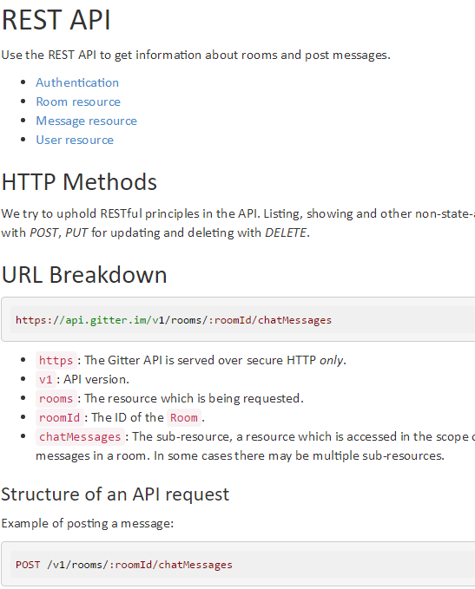
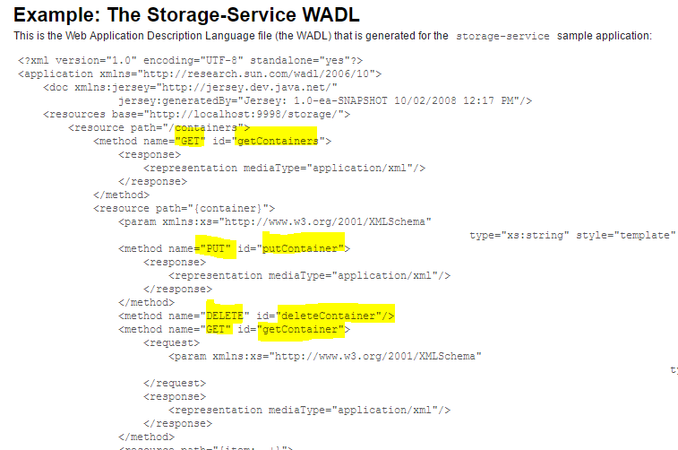
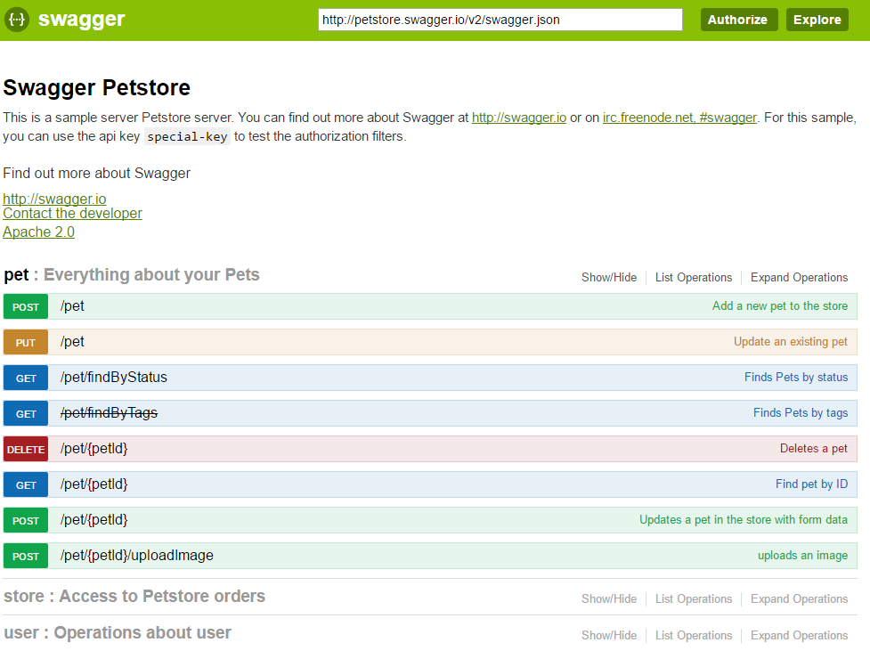
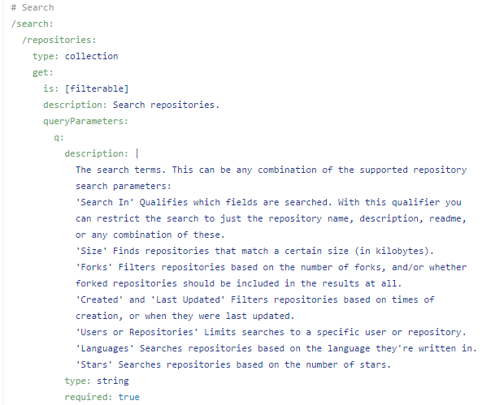
How Can I Figure Out What to Test?
Documentation
Swagger/OpenAPI
WADL/WSDL
RAML (RESTful API Modeling Language)

Slide 34
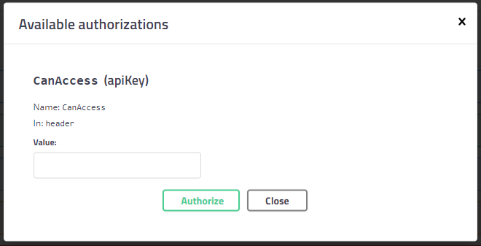
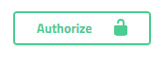
How Can I Figure Out What to Test?
https://localhost:8080/swagger

Slide 35
How Can I Figure Out What to Test?
Check out the code
Controllers
Models
Tests
https://github.com/g33klady/TodoApiSample

Slide 36
How is The UI Using The API?

Slide 37
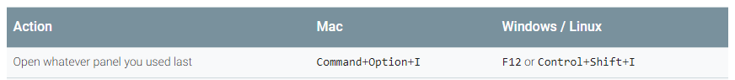
Dev Tools
https://localhost:8080

Slide 38
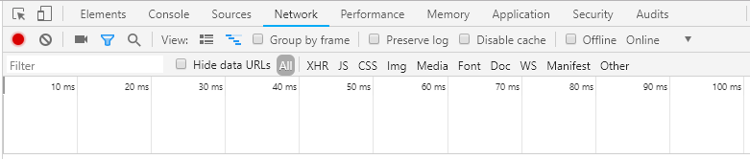
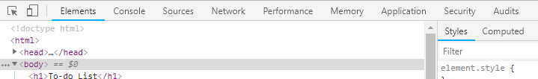
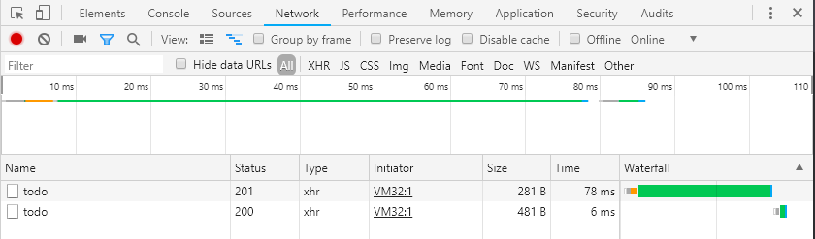
Network Tab

Slide 39
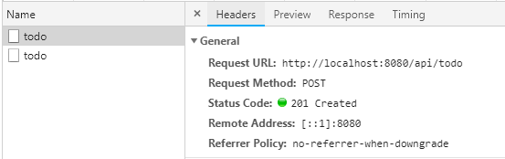
Network Tab

Slide 40
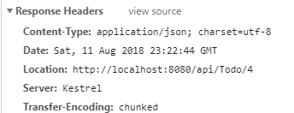
Network Tab

Slide 41
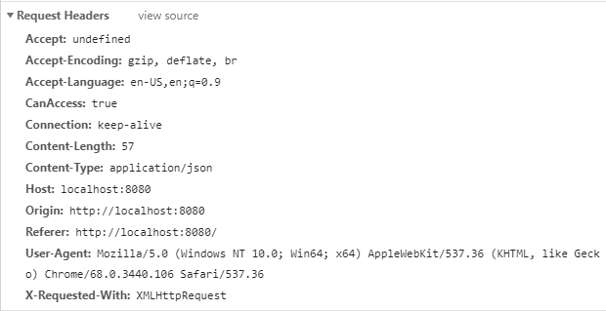
Network Tab

Slide 42
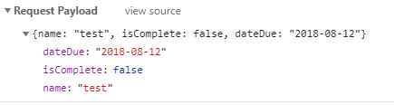
Network Tab

Slide 43
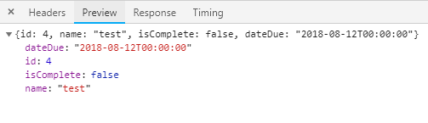
Network Tab

Slide 44
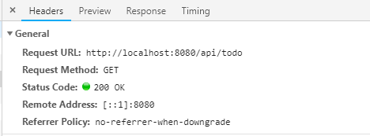
Network Tab

Slide 45
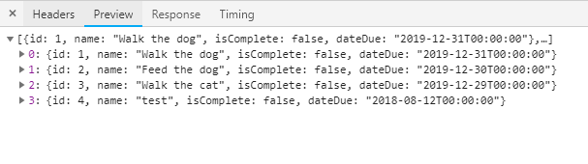
Network Tab

Slide 46
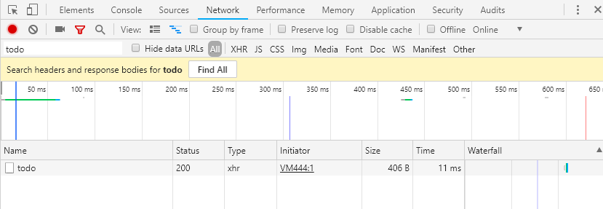
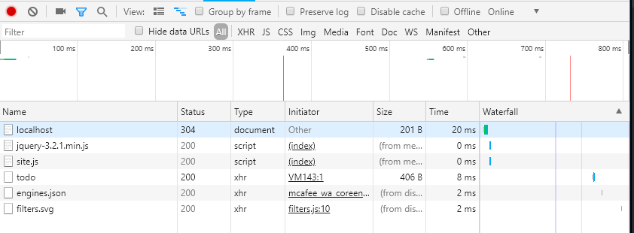
Network Tab - Filtering

Slide 47
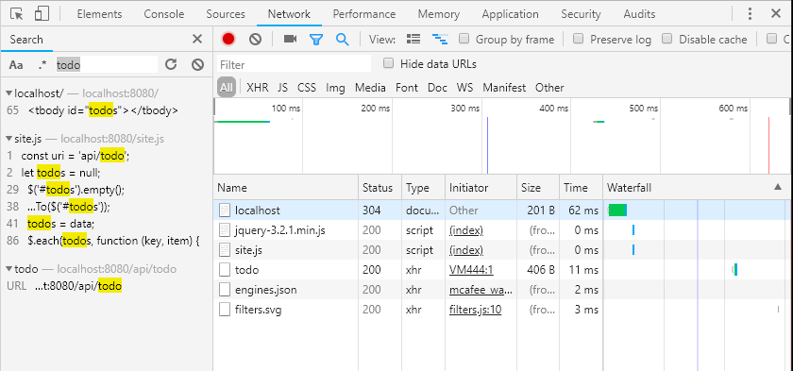
Network Tab - Filtering

Slide 48
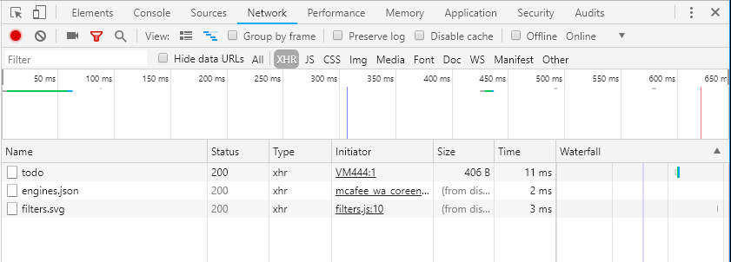
Network Tab - Filtering

Slide 49
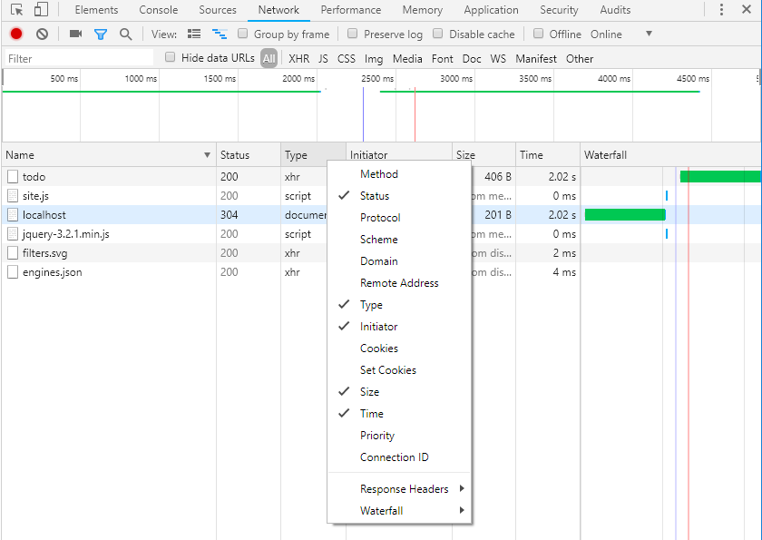
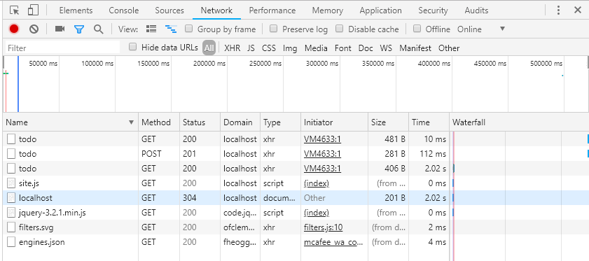
Network Tab - Filtering

Slide 50
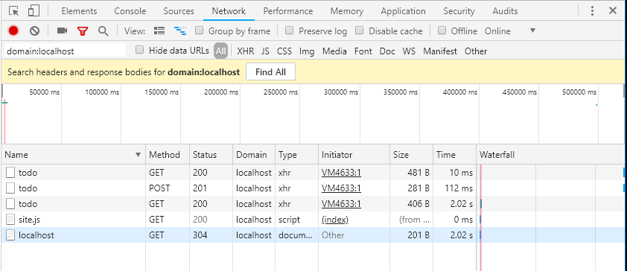
Network Tab - Filtering

Slide 51
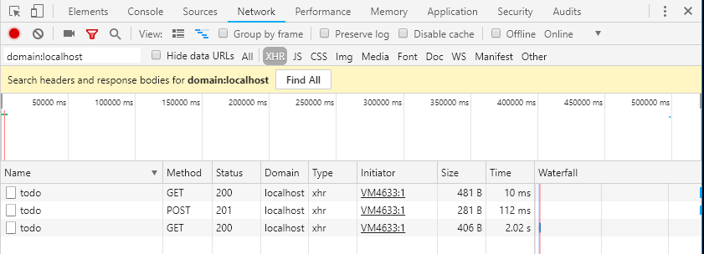
Network Tab - Filtering

Slide 52

Network Tab - Filtering Caution

Slide 53
Dev Tools
Try out all of the operations
Learn about our API and how the UI uses it
Compare your observations with Swagger
Regroup in 10 minutes

Slide 54
Observations

Slide 55
Notes
All browsers have dev tools
Other web proxy tools exist
Not all API calls are made via the UI

Slide 56
Getting Around Postman

Slide 57
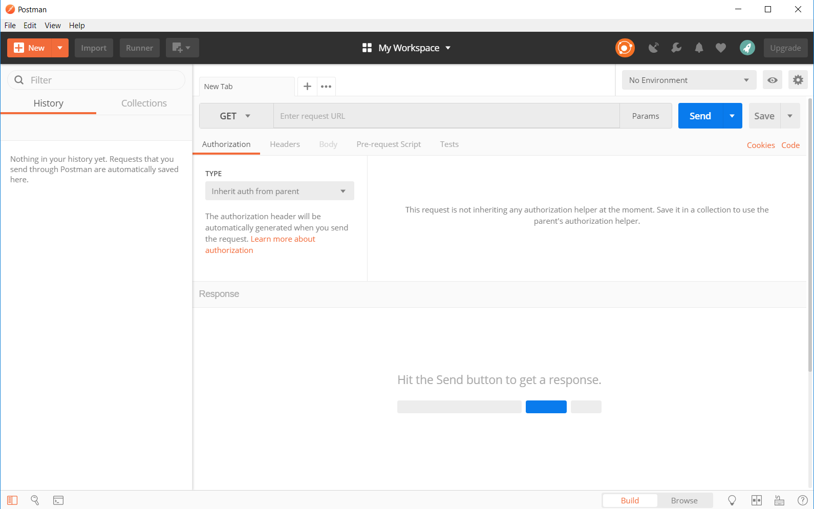
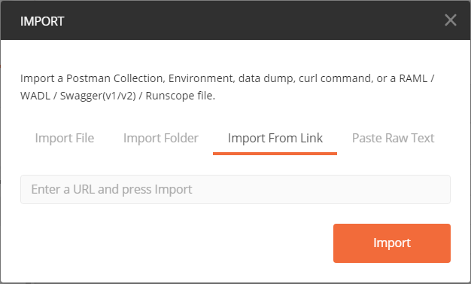
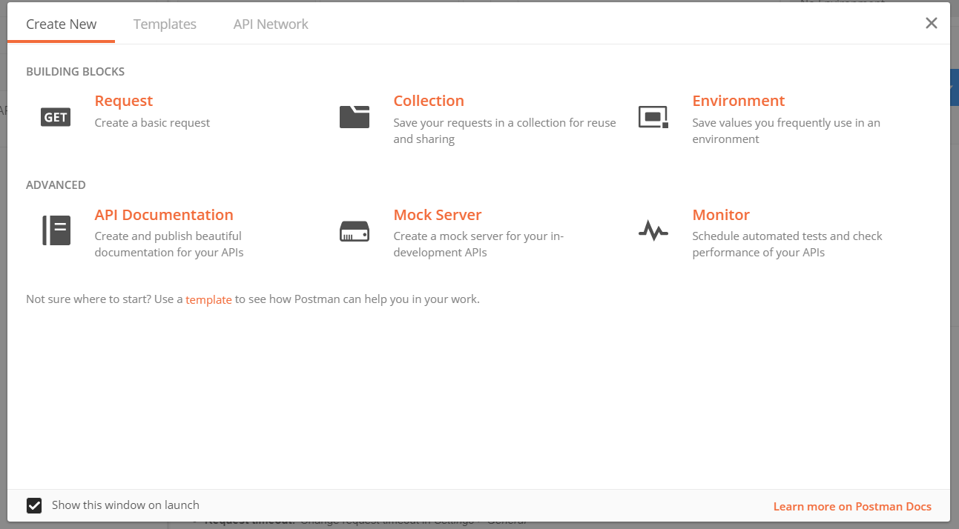
Create Our Collection

Slide 58

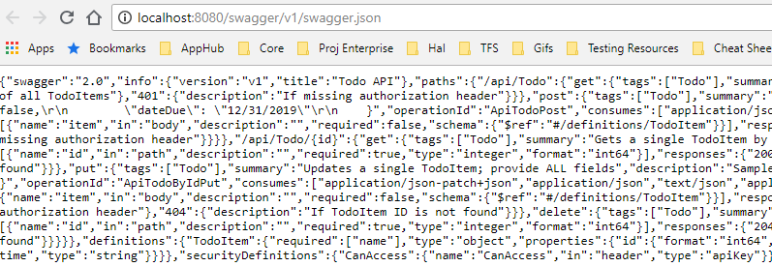
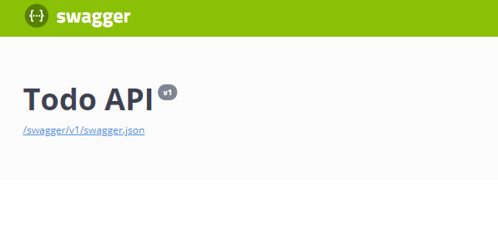
Create Our Collection

Slide 59
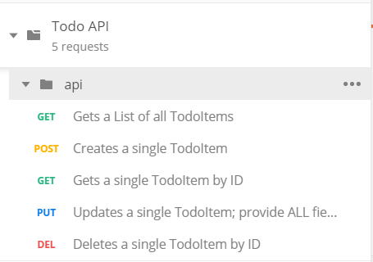
Getting Around in Postman
Check out each request
Methods
URL
Headers
Params
Request Body

Slide 60
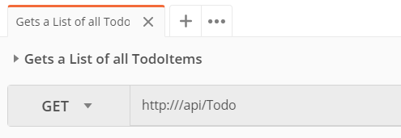
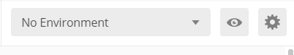
Variables

Slide 61
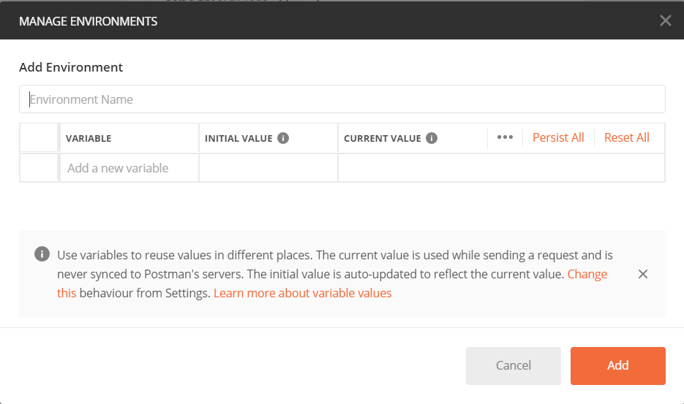
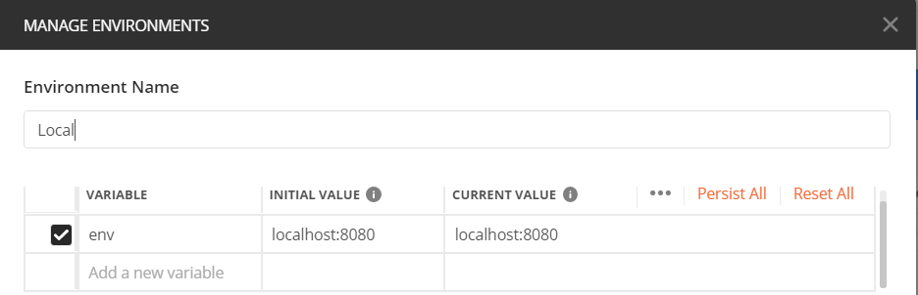
Variables

Slide 62
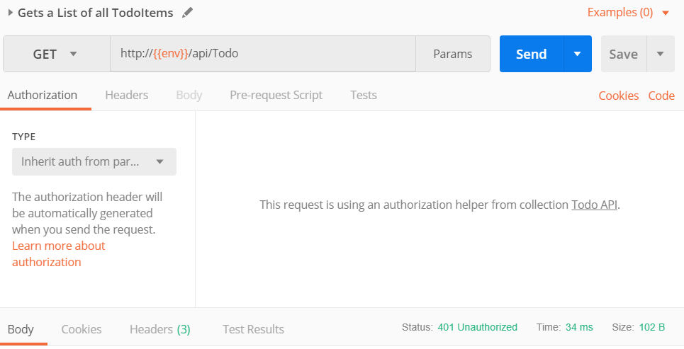
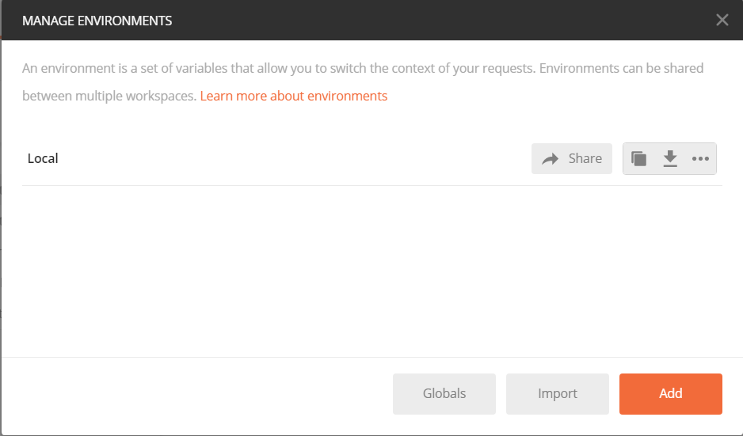

Getting Around in Postman

Slide 63


Getting Around in Postman

Slide 64

Getting Around in Postman

Slide 65


Getting Around in Postman

Slide 66

Getting Around in Postman

Slide 67


Getting Around in Postman
Save!

Slide 68
Getting Around in Postman
Update and save all requests
Add {{env}} variable to URL
Use Header Preset

Slide 69
Getting Around in Postman
Look back at our GET request
Response Body
Headers
Status Code
Time

Slide 70


Getting Around in Postman
Try a POST request
{ "name": "test", "isComplete": false }

Slide 71



Getting Around in Postman
Try a GET request for your new item

Slide 72


Getting Around in Postman
Try a PUT request for your new item

Slide 73
Getting Around in Postman
DELETE your new item
GET all items – is it really gone?

Slide 74



Getting Around in Postman

Slide 75


Getting Around in Postman

Slide 76


Getting Around in Postman

Slide 77


Getting Around in Postman

Slide 78

Getting Around in Postman
Do a new POST request (with a unique name)
Do a single item GET request

Slide 79


Getting Around in Postman
Collection features
Share it in your own documentation/git repo
Export as JSON for anyone to use
Monitoring
Mocking

Slide 80
Testing With Postman

Slide 81
CRUD Tests

Slide 82
Testing CRUD Operations
Create, Read, Update, Delete
Test separately to validate each method works
Test the lifecycle of an object
Catch issues with caching or concurrency
Create -> Read -> Update -> Read -> Delete -> Read

Slide 83
CRUD
Create
POST
Read
Update
PUT
Delete
DELETE
GET

Slide 84
Testing CRUD Operations
Actions | Expected Results
GET all Todo items | 200 OK; baseline of Todo items
POST new Todo item | 201 Created response with new item’s Id
GET all Todo items | 200 OK; baseline plus new Todo items appear correctly
GET new Todo item | 200 OK; new Todo item appears correctly
PUT new Todo item | 204 No Content response
GET all Todo items | 200 OK; baseline plus updated new Todo item appear correctly
GET new Todo item | 200 OK; updated new Todo item appears correctly
DELETE new Todo item | 204 No Content response
GET all Todo items | 200 OK; baseline only (new/updated item is not shown)
GET new Todo item | 404 Not Found

Slide 85
Boundary Testing

Slide 86

Testing Boundaries
Above and below numerical limits
Value must be <= 19.9 and Value must be > 0

Slide 87
Testing Boundaries
Item Name
1-255 Characters
Due Date
Month
Day
Year

Slide 88
Testing Boundaries
Actions | Expected Results
POST new Todo item with 255 chars for Name | 201 Created response with new item’s Id
POST new Todo item with 256 chars for Name | 400 Bad Request response w/ proper error message
POST new Todo item with 0 chars for Name (empty string) | 400 Bad Request response w/ proper error message
POST new Todo item with 1 chars for Name | 201 Created response with new item’s Id
POST new Todo item with Date being 2 weeks ago | 400 Bad Request response w/ proper error message
POST new Todo item with Date being 2 weeks in the future | 201 Created response with new item’s Id
POST new Todo item with Date February 31st 2020 | 400 Bad Request response w/ proper error message
POST new Todo item with Date being today | 201 Created response with new item’s Id

Slide 89
Testing Boundaries
Actions | Expected Results
POST 4 new Todo items with name “test” and note Ids
PUT item 1 with 255 chars for Name | 204 No Content response
PUT item 2 with 256 chars for Name | 400 Bad Request response w/ proper error message
PUT item 3 with 0 chars for Name (empty string) | 400 Bad Request response w/ proper error message
PUT item 4 with 1 chars for Name | 204 No Content response
POST 4 new Todo items with Date of tomorrow and note Ids
PUT item 1 with Date being 2 weeks ago | 400 Bad Request response w/ proper error message
PUT item 2 with Date being 2 weeks in the future | 204 No Content response
PUT item 3 with Date February 31st 2020 | 400 Bad Request response w/ proper error message
PUT item 4 with Date being today | 204 No Content response

Slide 90
Required Fields

Slide 91
Testing Required Fields
If required data is omitted, it yields an accurate response
If I fail to submit required information
Will I be able to understand how to fix it?
Is it handled gracefully?
Is the request processed as if it wasn’t required?

Slide 92



Testing Required Fields

Slide 93
Testing Required Fields
Actions | Expected Results
POST new Todo item with no fields specified (empty JSON) | 400 Bad Request response w/ proper error message
POST new Todo item with Name field null | 400 Bad Request response w/ proper error message
POST new Todo item with 0 chars for Name (empty string) | 400 Bad Request response w/ proper error message
POST item with valid Name for PUT tests
PUT new Todo item with no fields specified (empty JSON) | 400 Bad Request response w/ proper error message
PUT new Todo item with Name field null | 400 Bad Request response w/ proper error message
PUT new Todo item with 0 chars for Name (empty string) | 400 Bad Request response w/ proper error message

Slide 94
Field Types

Slide 95

Testing Field Types
If the client sends a different data type than what is expected
Expect INTEGER, send
STRING
DECIMAL
☃

Slide 96


Slide 97
Testing Field Types
Actions | Expected Results
POST new Todo item with Name being Unicode Snowman (☃) | 201 Created response with new item’s Id
POST new Todo item with name “test” for PUT test
PUT item with Name Unicode Snowman (☃) | 204 No Content response

Slide 98
Testing Field Types
Actions | Expected Results
POST new Todo item with DateDue being “abcd” | 400 Bad Request response w/ proper error message
POST new Todo item with DateDue being false | 400 Bad Request response w/ proper error message
POST new Todo item with DateDue being 1234 | 400 Bad Request response w/ proper error message
POST 3 new Todo items with DateDue being tomorrow for PUT tests
PUT item 1 with DateDue being “abcd” | 400 Bad Request response w/ proper error message
PUT item 2 with DateDue being false | 400 Bad Request response w/ proper error message
PUT item 3 with DateDue being 1234 | 400 Bad Request response w/ proper error message

Slide 99
Failure

Slide 100
Testing for Failure
Testing for (mostly) uncontrollable circumstances
404 Not Found Errors
500 Internal Server Error
Timeouts
Server Down
Database not responding

Slide 101
Testing for Failure
Actions | Expected Results
GET Todo item that doesn’t exist | 404 Not Found response
PUT Todo item that doesn’t exist | 404 Not Found response
PUT with no item Id | 400 Bad Request response w/ proper error message
DELETE item that doesn’t exist | 404 Not Found response
DELETE with no item Id | 400 Bad Request response w/ proper error message

Slide 102
Testing for Failure
How does the UI react when our API has these issues?
What happens if a 3rd Party API has these issues?
Use Service Virtualization!
Hoverfly
WireMock

Slide 103
Security

Slide 104
Testing Security
Authentication vs. Authorization
Authentication (who they are)
Authorization (what they can do)
Does the request have a valid token?
Does the token allow access to this resource?

Slide 105
Testing Security
Encryption
Use a proxy to see what the requests look like “over the wire”
Fuzzing
Sending tons of malformed data and see where it breaks
SQL Injection
Cross-Site Scripting

Slide 106

Testing Security

Slide 107
Exploratory

Slide 108
Exploratory Testing
“Exploratory Testing” is a style of testing in which we learn about the behavior of a system by designing a small test, executing it immediately, using the information gleaned from the last test to inform the next.
-Elisabeth Hendrickson
Not scripted
Not pre-planned
Let the application lead you
Use your past experience as heuristics

Slide 109
Exploratory Testing Web Services
Apply the same principles as with a GUI interface
Think about other uses
What else uses the API now?
What else could use the API in the future?

Slide 110
Exploratory Testing Web Services
Explore the application!
Bugs = Prizes!

Slide 111
Let’s Stop Our App!
docker stop myapp

Slide 112
Test Those Web Services!

Slide 113
Test Those Web Services
Not always a pretty UI for end users
Bugs in Web services cause just as many headaches for users
Different skill set for testers
A lot of the same principles
Seems complicated
Just a different window into our applications
Combinations are endless
Use the API to feed your UI testing, and vice versa
Web Services Need Testing Love, Too!

Slide 114
That’s it!
Questions?

